Slide 1
Virtual Community Update
December 16, 2025

Slide 2
Topics
Guest Presenters
Project Update
Commuter Options
Advancing the Rebuild
Pre-Construction Activities
Engagement
Questions & Answers

Slide 3
Project Update

Slide 4
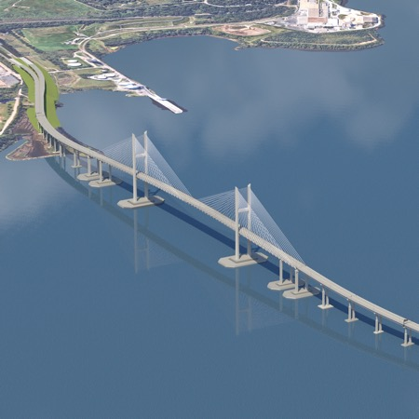
Cost and Schedule
Updated Cost & Schedule
  Estimated cost range: $4.3–$5.2 billion
  Anticipated open-to-traffic: Late 2030
Early Cost Estimates
  Initial estimate developed less than two weeks after the collapse
  Required to secure federal funding with limited information
  Design was at 0%, with no engineering studies completed
Accelerated Progress
  In just 14 months, the project advanced to 70% design
  Progress typically takes 6–7 years on projects of this scale
  Pre-construction activities and updated data informed
  refined estimates

Slide 5
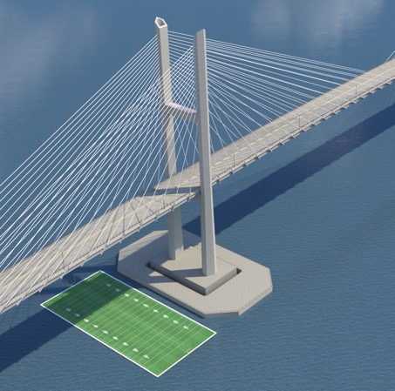
Cost and Schedule
Key Cost Drivers
  Enhanced pier protection meeting federal safety requirements
  Higher and longer main-span to accommodate marine traffic
  Volatile construction market conditions
Modern Standards & Requirements
  Designed to meet modern design standards,
  federal requirements, national best practices
  Federal navigation clearance requirements,
  including a 230-foot height

Slide 6

2018
2019
2020
2021
2022
2023
2024
2025
JAN –
JUN
JUL -
DEC
JAN –
JUN
JUL -
DEC
JAN –
JUN
JUL -
DEC
JAN –
JUN
JUL -
DEC
JAN –
JUN
JUL -
DEC
JAN –
JUN
JUL -
DEC
JAN –
JUN
JUL -
DEC
JAN –
JUN
JUL -
DEC
Francis Scott Key Bridge
15%
70%
PROJECT COST:
$1.9B
$4.3-5.2B
Mobile
River Bridge
30%
60%
PROJECT COST:
$1.26B
$1.5B
$2.1B
?
Brent Spence Bridge
30%
60%
PROJECT COST:
$2.8B
$3.6B
?
Gordie-Howe Bridge
30%
Open to Traffic
PROJECT COST:
$2.68B
$4.64B

Slide 7
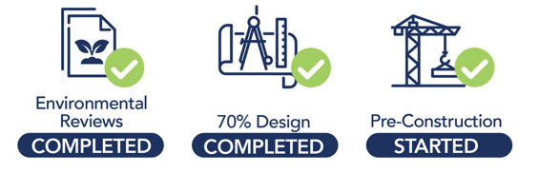
Cost and Schedule
Construction Moving Forward
  Construction expected to begin next year,
  with efforts underway to address
  Baltimore-area traffic impacts
Commitment to Delivery
  Teams are working around the clock to deliver a safe, modern bridge the community can be proud of
Strong Federal & Project Partnerships
  Ongoing coordination with FHWA and design partner Kiewit on permitting, design, cost, and schedule
Protecting Taxpayers
  Maryland continues pursuing responsible parties to recover reconstruction costs and minimize taxpayer burden

Slide 8
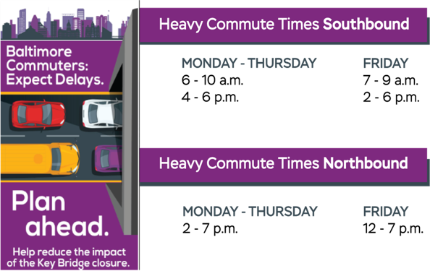
Traffic and Travel Impacts
Thank you for adjusting routes, carpooling, and using transit
Traffic has shifted to the Fort McHenry and Harbor tunnels
Expect longer rush hours and delays on I-95 and I-895
Traffic is monitored daily, with temporary solutions in place
Targeted toll and roadway adjustments are helping improve traffic flow

Slide 9
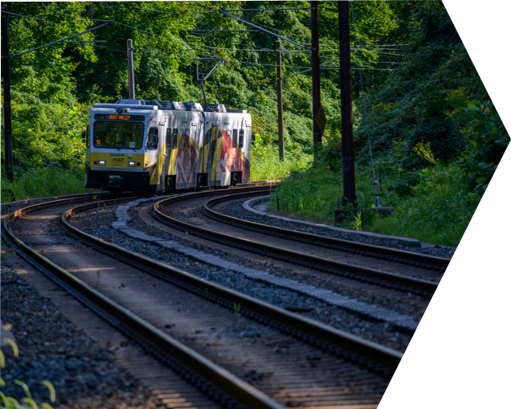
Managing Mobility Post FSK Impact
December 16, 2025​

Slide 10
Goal: Relieve Impacts to Commuters
Helping Travelers Post-FSK Bridge Collapse:
Best real-time information possible
Adjust transport operations
Providing new travel options
Deliver Measurably Better Benefits:
Reducing congestion
Increase convenience
Minimize impacts on local communities

Slide 11
Related Mobility Offerings
Commuter Choice Maryland free commuter benefits (resources and incentives)
Transit Royale App provides real-time arrival information across transit modes
CHART Travel Time Website displays travel routes and travel times
Signalization and Timing Improvements to 30 signals during the initial 5-month period following the bridge collapse

Slide 12
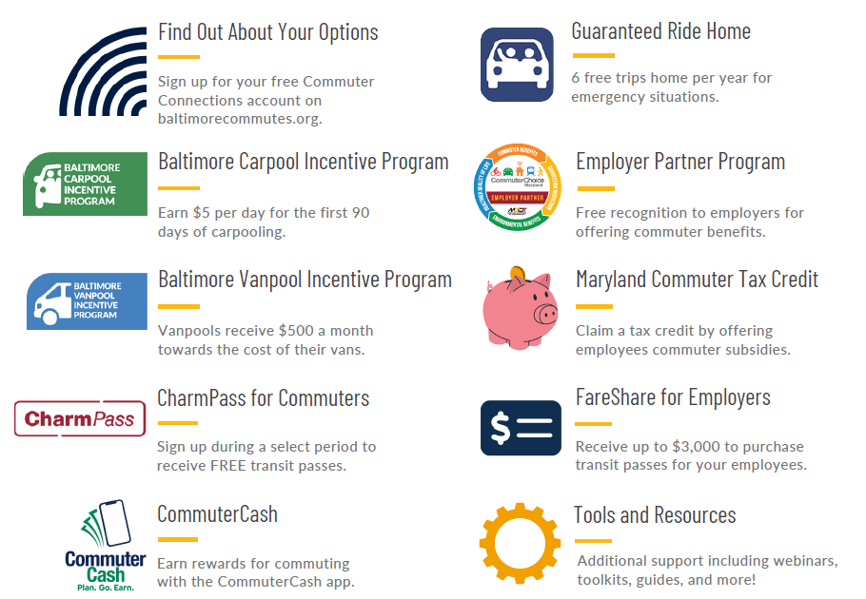
Commuter Choice Maryland’s Free programs and tools!
Commuters, visit:
Baltimorecommutes.org
Employers, contact:
commuterchoice@mdot.state.md.us

Slide 13
Ride Together Rewards: Transit Incentives Program, Carpool Incentive Program, Vanpool Incentive Program
MDOT’s new Transit Incentive Program is making it easier to ride the bus and train in the Greater Baltimore area with two new incentives.
  Commuter Incentive: During select promotional periods, new transit users can download the CharmPass mobile app and receive FREE transit passes.
  Employer Incentive: Employers can receive up to $3,000 to purchase transit passes for your employees through the FareShare program.
Unlock a new commute with the Vanpool Incentive Program.
  Vanpools in the Baltimore region now qualify for a $500 monthly incentive through the new Baltimore Commutes Vanpool Incentive Program!
Utilize the Carpool Incentive Program for your commute and earn rewards for the first 90 days!
  Employees who carpool to work in the Baltimore region now qualify for a $5 daily incentive during a 90-day special incentive period through the new Baltimore Commutes Carpool Program!
Visit: BaltimoreCommutes.org or mdot.maryland.gov/transitincentives

Slide 14
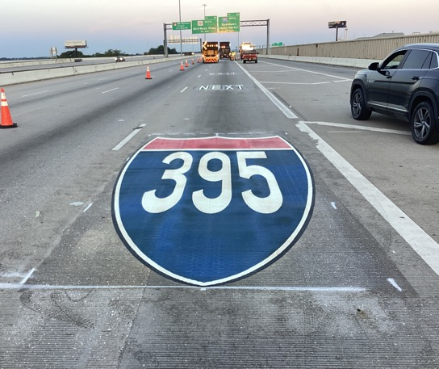
Ongoing Effort to ID New Actions
Coordination with TSO, SHA, MTA, MDTA and Local Jurisdictions, Partner Employers
Areas coming online:
  New transit incentive programs
  Physical infrastructure enhancements
  Targeted Corridor benefits
  Increased engagement with employers

Slide 15
Join up to improve the commute!
Commuter Connections
tdm.commuterconnections.org/mwcog/

Slide 16
Advancing the Rebuild

Slide 17
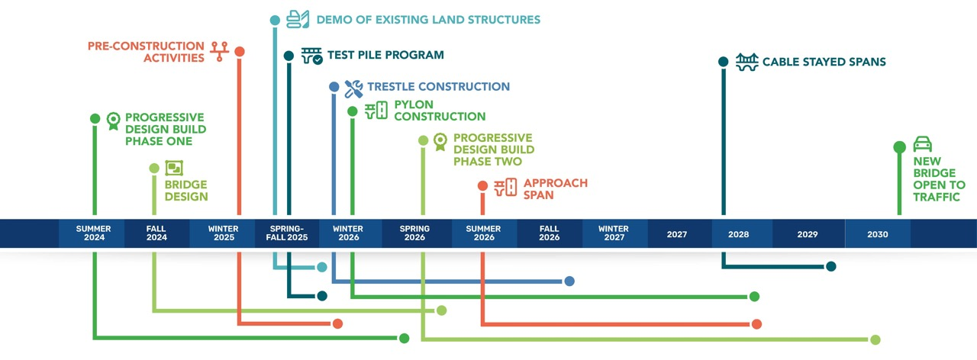
Delivering the Safe and Efficient Reconstruction of the Key Bridge
*SCHEDULE IS SUBJECT TO CHANGE

Slide 18
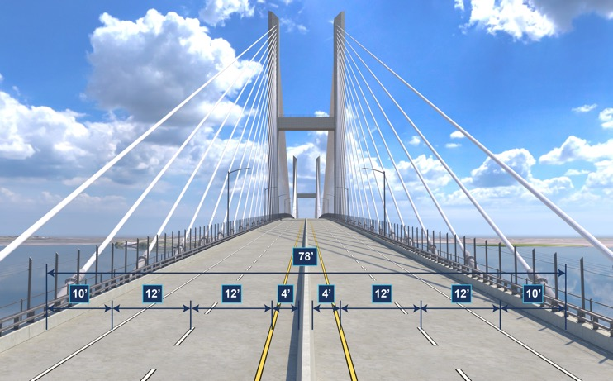
Typical Roadway Section
The roadway has two 12-foot lanes in each direction, with a 10-footoutside shoulder and 4-foot inside shoulder, meeting Interstate standards.
A 5-foot maintenance walkway runs along each side of the cable-stayed span, with cables set back from traffic for safety and improved wind stability.
Barriers are 42” tall to comply with current safety standards.

Slide 19
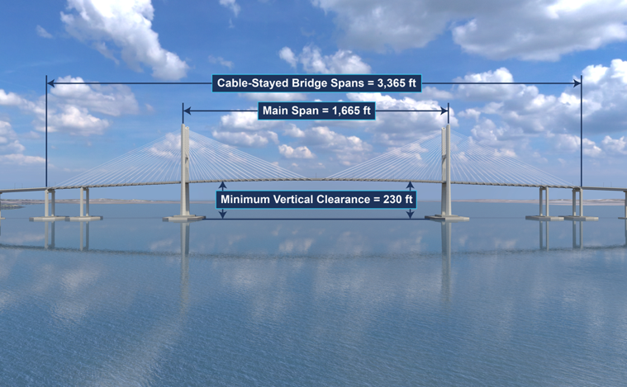
Cable-Stayed Bridge
The cable-stayed bridge is 3,365 feet long and supported by six piers, including the two main pylons.
The 1,665-foot main span is the longest cable-stayed span in the U.S. and provides 230 feet of clearance for marine traffic.
The bridge is supported by 144 cables, which distribute the deck’s weight evenly.
Each pylon tower rises over 600 feet above the river, with a column that tapers as it ascends.

Slide 20
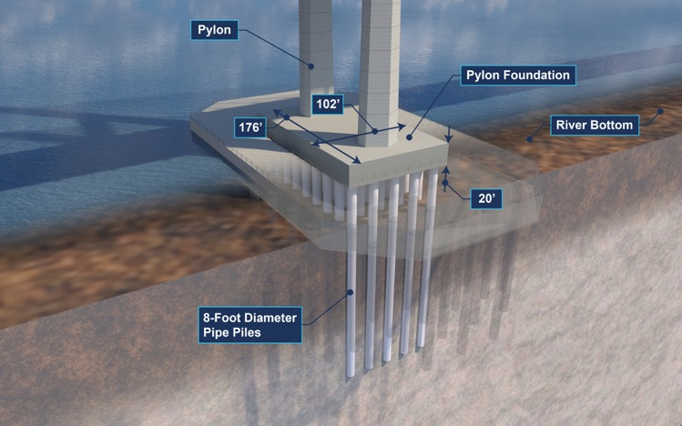
Pylon Foundations
Each foundation is supported by 45 massive steel piles, each over 200 feet long and 8 feet in diameter, anchored deep into the Patapsco geological layer.​
The footing itself is roughly the size of two NBA basketball courts and stands 20 feet thick.​
More than 13,000 cubic yards of concrete—about 26,600 tons—goes into each footing.​
Constructing each foundation takes over 1,300 truckloads of concrete, placed in three layers.

Slide 21
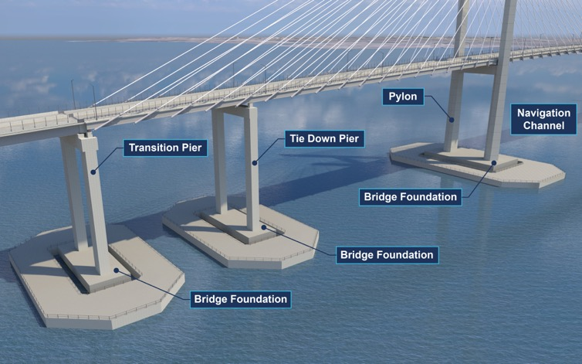
Cable-stayed Bridge Foundations
The cable-stayed bridge foundations include six total piers.​
​This includes the two main pylons along with a tie-down and transition pier on each side of the main span.
​
​Tie-down piers and transition piers each have 10 steel piles that are 8 feet in diameter in every foundation.​
​In total, the cable-stayed bridge foundations use 130 piles, each 8 feet in diameter.

Slide 22
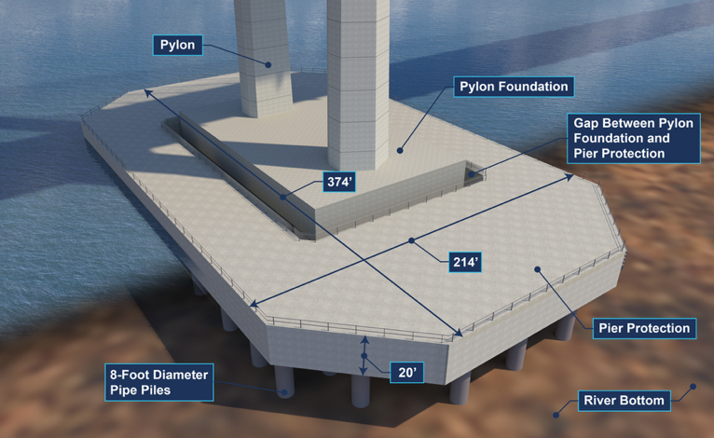
Pier Protection System
Each main pylon protection fender is longer and wider than an NFL football field and over 20 feet thick
Each of these foundations is supported by 78 steel pipe piles, each 8 feet in diameter
In total, the bridge’s vessel protection system uses 276 concrete-filled steel piles, each 8 feet in diameter.

Slide 23
Pre-Construction Activities

Slide 24
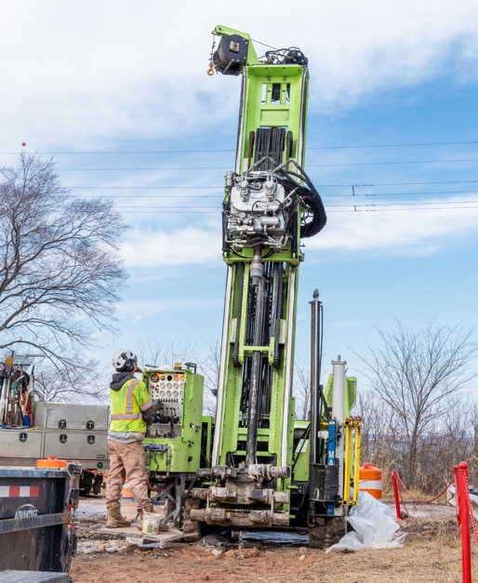
Geotechnical Borings​
Investigation program included land and marine borings which are deep, narrow holes drilled into the ground to collect soil samples ​
Samples provide data to develop safe, durable, and efficient structures tailored to site-specific ground conditions
The boring program is complete

Slide 25
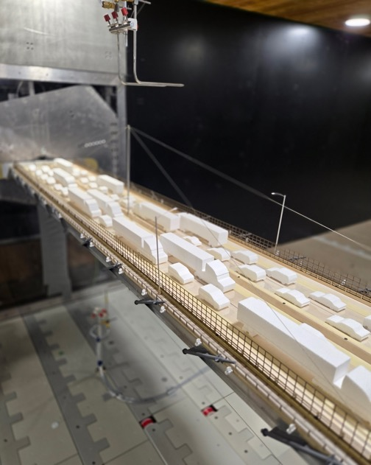
Wind Tunnel Testing
Simulated real-world wind conditions to study how the structure responds​
Fine-tuned the bridge shape, ensuring it will withstand powerful winds and extreme weather, even with heavy traffic

Slide 26
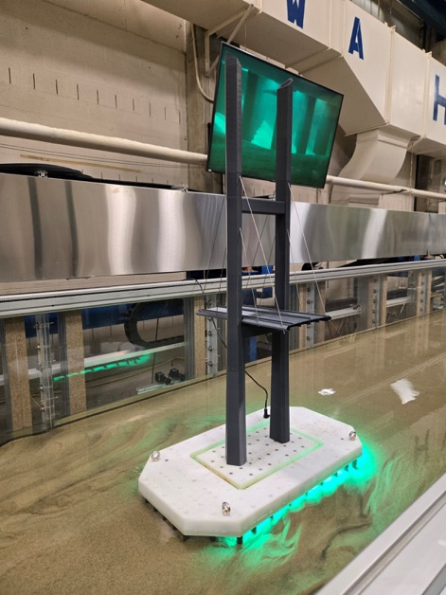
Scour Testing
Simulated real-world water flow around piles to study how the riverbed responds​
Identified potential challenges like scour
Informed the pile design, ensuring it can withstand the impact of scour

Slide 27
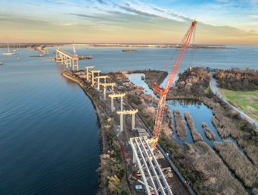
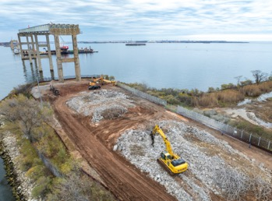
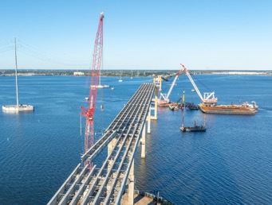
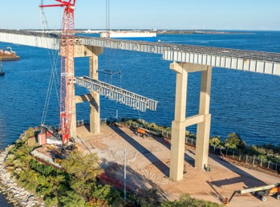
Mechanical Demolition
Mechanical demolition is using heavy machinery to remove existing bridge structures​
Land and over water demolition will occur in separate phases
Land demolition began in July 2025

Slide 28
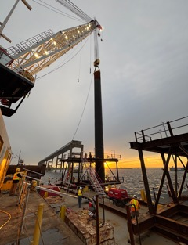
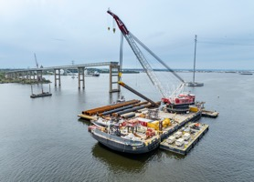
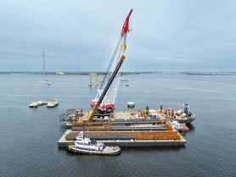
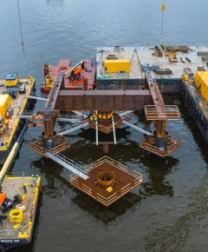
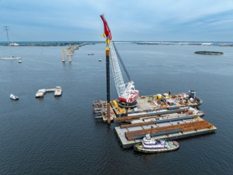
Test Pile Program
Test pile driving is used to advance the design of the main span foundations​
Periodic test pile driving began in October 2025 and is expected to continue through early 2026
Test piles are 8 feet in diameter and over 200 feet in length

Slide 29
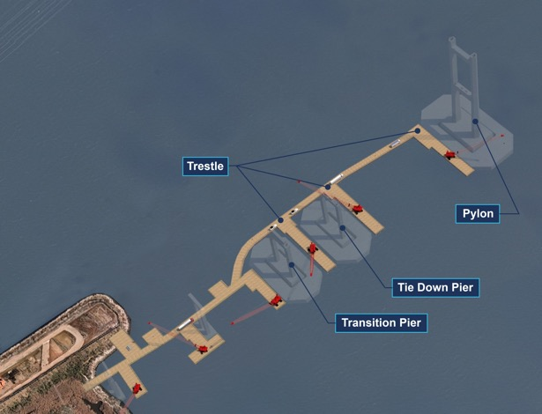
Trestle Construction
Work is underway at Hawkins Point to prepare for a temporary work platform or trestle.
The trestle will let supplies, labor, and equipment reach the pier sites more efficiently, speeding up construction.
In December, crews will begin driving piles to extend a trestle from Hawkins Point.
In early 2026, crews will start building a second trestle from Sollers Point.

Slide 30
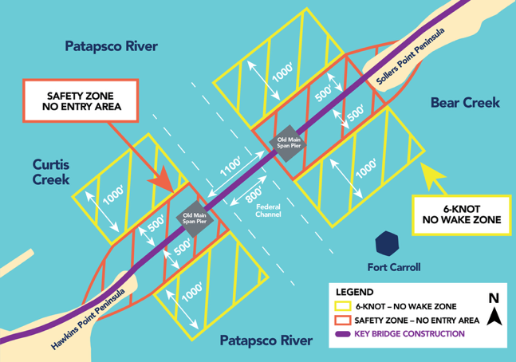
Safety on the Water
Safety remains the top priority as trestle and production pile work ramps up.
Safety Zone – No Entry Area is in effect; coordinated with the USCG since July 2025.
6-Knot No Wake Zone established in August 2025 to protect boaters and construction crews.
Federal Channel remains open, with no speed restrictions.

Slide 31
Engagement

Slide 32
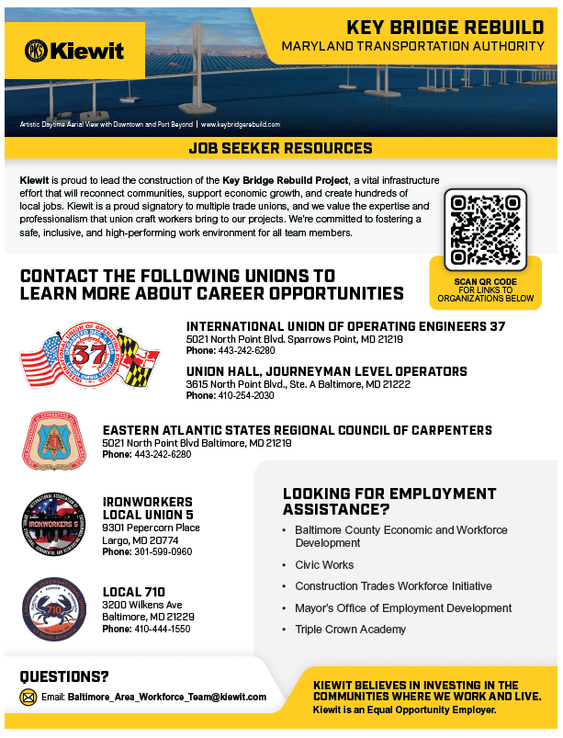
Opportunities with Kiewit
Phase 1 of the project is approaching completion
Kiewit will begin soliciting subcontractor pricing (in Q4 2025) for inclusion in the Phase 2 cost estimate
Kiewit is currently seeking to engage with local and small firms interested in subcontracting opportunities on the Project

Slide 33
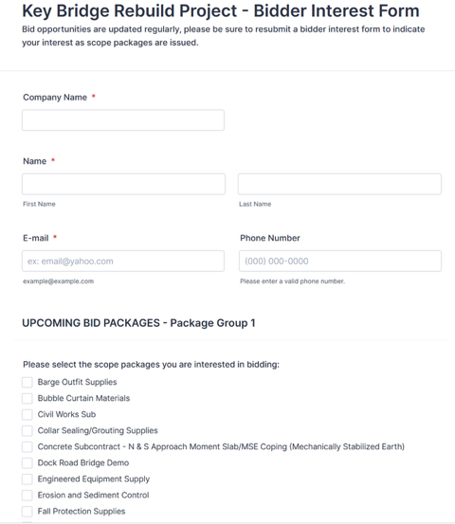
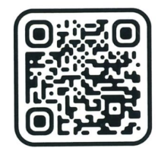
Access Bid Opportunities
Express Your Bidding Interest*
View the list of current solicitations and indicate the scope packages your company is interested in bidding at: https://bit.ly/KeyBridge-BidderInterest
* Bid opportunities are updated regularly. Please be sure to resubmit a bidder interest form to indicate your interest as scope packages are issued.
Scan the QR code to join our subcontractor and supplier database.

Slide 34
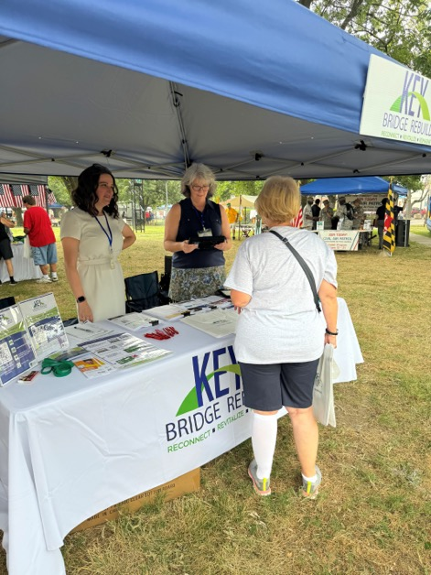
Engagement
100+ pop-up events
50+ speaking engagements​
860+ surveys taken
6,180+ connections with communities
4,200+ email subscribers
26,000+ Facebook subscribers

Slide 35
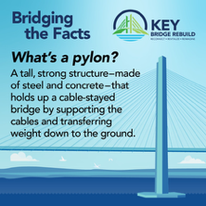
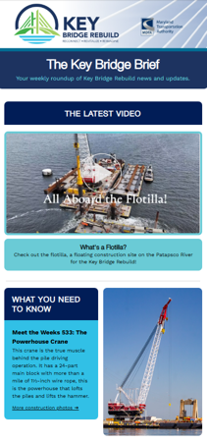
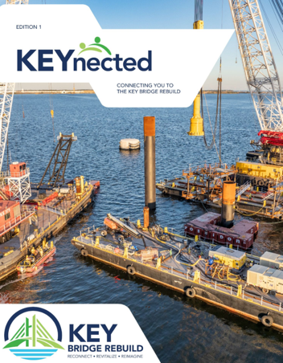
Be on the look out!
Bridging the Facts Facebook series
Weekly Key Bridge Brief eblast
KEYnected Project Newsletter

Slide 36
Stay Connected
800-515-7030
Public Information Hotline
KeyBridgeRebuild.com
Sign up for project alerts by email or text
Invite us to speak in your community
Share feedback through email or project hotline
Follow us on Facebook for project updates
@KeyBridgeRebuild
info@KeyBridgeRebuild.com
Key Bridge Rebuild
2310 Broening Highway
Baltimore, MD 21224

